Slide 1


Kathará A Lightweight and Scalable Network Emulation System
Mariano Scazzariello
mariano.scazzariello@uniroma3.it

Slide 2
What is it?
Kathará is a network emulation system
Allows users to run real network software in a virtual environment in order to perform tests and experiments on networks
Used worldwide by many universities and companies
Including some big Internet players
Website: kathara.org

Slide 3

An Open-Source Project
Kathará is completely open-source, and written in Python
The main repository is hosted on GitHub:
github.com/KatharaFramework/Kathara
The project numbers:
Used by more than 20 courses in more than 10 universities worldwide
>50k downloads
Almost 1k commits
16 contributors around the world
220 stars

Slide 4

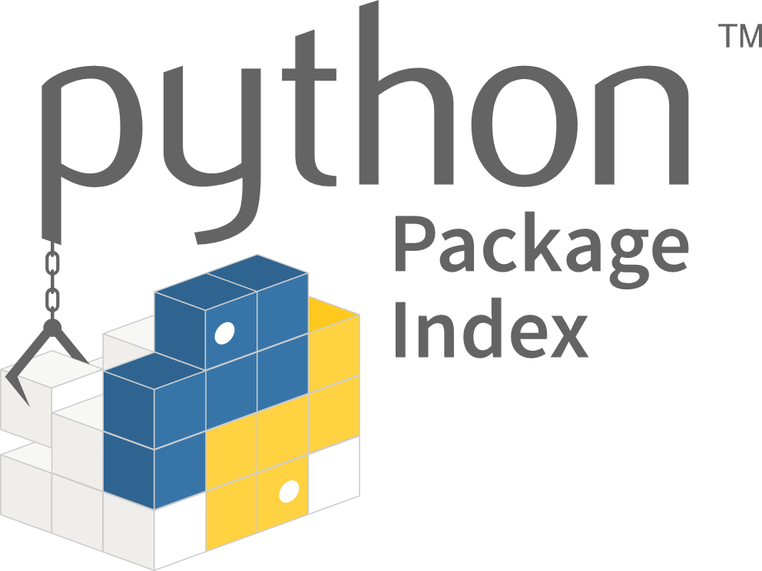


Support and Compatibility
Kathará is available on all the main Operating Systems
As far as we know, the only network emulator supporting all of them
We also ship a Python package available on PyPI:
pypi.org/project/kathara/
Complete installation guides can be found in the Wiki:
github.com/KatharaFramework/Kathara/wiki/Installation-Guides

Slide 5
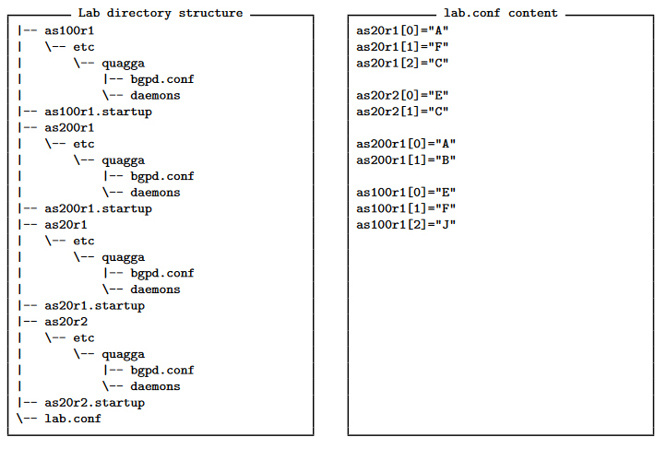

Network Scenario
Simple configuration language to describe a network scenario
A network scenario is represented as a directory, containing:
A file with the network topology (lab.conf)
For each device, files and folders containing the real configuration of that device
A
C
as200r1
as20r1
as20r2
B
F
E
as100r1
J

Slide 6





Scalability
More than 1000 devices on a common laptop
(6C-12T/16GB RAM)
More than 2000 devices on a single server
(32C-64T/512GB RAM)
No limits on a Kubernetes cluster

Slide 7
Use Cases

Slide 8
Configuration Testing
Deploy arbitrary complex scenarios for testing configurations before deploying them in the production network
Interoperability testing between configurations, versions and different implementations
Leveraging on L2 virtual networks, it is also possible to run non-IP-based protocols (e.g., IS-IS)

Slide 9
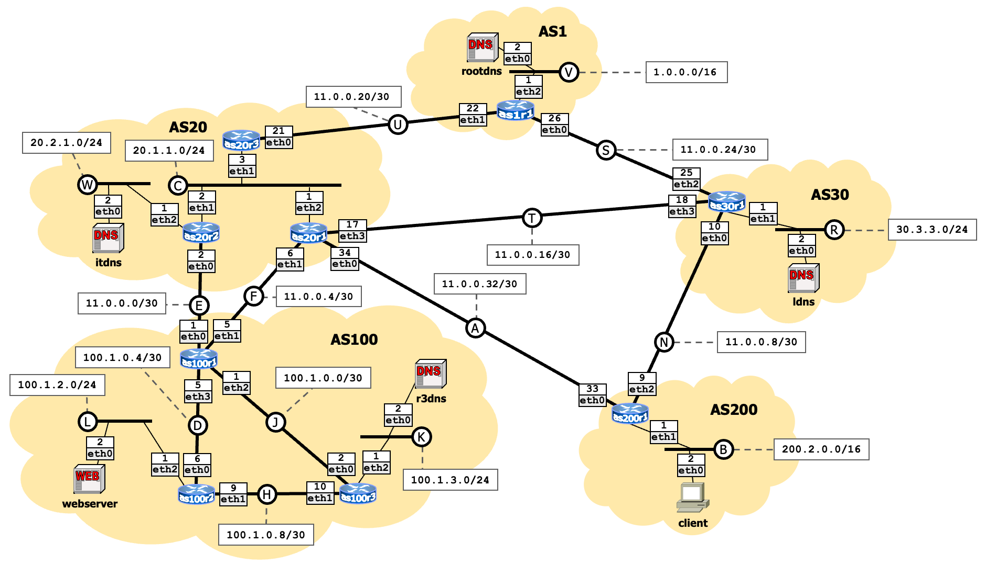
Configuration Testing – Example Scenario

Slide 10
What-If Scenarios for Security Assessment
Possibility to test what-if scenarios for security assessment
Analyze how configuration changes are reflected inside and outside your network
Analyze possible attacks and test the efficiency of the implemented countermeasures

Slide 11


What-If Scenarios for Security Assessment
AS3333
AS1
krill
WEB
webserver
as3333r1
as1validator
AS4
as1r1
client
as2r1
as3r1
AS2
AS3
as2validator
as4r1
as3validator
as4validator
as5r1
as6r1
as7r1
AS5
AS6
AS7
as5validator
as6validator

Slide 12
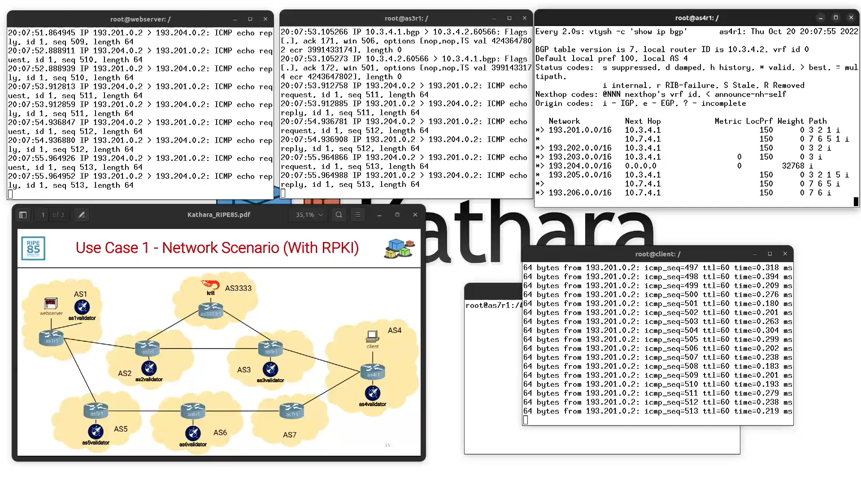
What-If Scenarios for Security Assessment

Slide 13
Building a Network Testing Pipeline
Python APIs allow to build complex frameworks on top of Kathará
Operators can build complete network testing pipelines to automatically deploy and assess configuration changes
Vendors can build an integration testing pipeline for supporting protocols and NFs development

Slide 14
Assess Routing Protocols Implementations
Define a methodology and implement a software framework (Sibyl) for testing routing protocol implementations
Sibyl leverages on Kathará to automatically deploy fat-tree topologies and test routing protocols in hyper-scale datacenters
Tested on topologies up to 1.3k routers and 33k interfaces
Automatically computes standard and novel metrics for analyzing the protocols behaviour
Sibyl: a Framework for Evaluating the Implementation of Routing Protocols in Fat-Trees. Caiazzi, Scazzariello, Alberro, Ariemma, Castro, Grampin, Di Battista. NOMS 2022. Available here.

Slide 15
Summary
Deploy more than 1K devices on a common laptop
No scalability constraints with the distributed mode
Possibility to emulate networks for operational and research purposes with support to all major routing protocols and suites
Allow to build frameworks for testing implementations and configurations of generic network scenarios

Slide 16







Contacts
Roma Tre – Computer Networks and Security Research Group
Mariano Scazzariello
mariano.scazzariello@uniroma3.it
Tommaso Caiazzi
tommaso.caiazzi@uniroma3.it
Lorenzo Ariemma
lorenzo.ariemma@uniroma3.it
Website
github.com/KatharaFramework/Kathara
linkedin.com/company/kathara
contact@kathara.org

